Slide 1
PCA
Powerful tool to visualise high-dimensional data
Shows quantified difference among observations
Used to asses data quality and discover relationship between data points

Slide 2
PCA
Alternative coordinate systems
y
x
y'
y
x'
x

Slide 3
Hierarchical Clustering
genes
control5
control2
case1
case3
case5
case4
case6
case2
case7
control3
control6
control7
control1
control4
samples

Slide 4
Statistical Learning with Sparsity
A sparse statistical model is one on which only a relatively small number of parameters (or predictors) play an important role.
For example, we hope that not all of the 30,000 or so genes in the human body are directly involved in the process that leads to the development of cancer.
Methods that study sparsity to help recover the underlying signal of the data.
Methods
Linear regression
Generalised Linear Regression
Generalisation of the Lasso Penalty
Statistical Inference
The Bayesian Lasso (Park and Cosella 2008)
The Bootstrap (Efron 1979; Efron and Tibshirani 1993)
Sparse Multivariate Methods
Graph and Model Selection

Slide 5
Linear regression
In which we observe N observations of an outcome variable y_{i} and p associated predictor variables (or features) x_{i} = (x_{i1}, …, x_{ip})^{T}. The goal is to predict the outcome from the predictors, both for actual prefiction with future data and also to discover which predictors play an important role.
where β_{j} represents the parameters to be estimated
Algorithms
Least squares
Suitable when the response variable is quantitative and ideally when the error distribution is Gaussian.
Lasso
Prediction accuracy over least squares for two reasons:
1. Least squares estimate often has low bias but large variance, and prediction accuracy can someties be improved by shrinking the values of regression coefficients, or setting some coefficients to zero. By doing so we introduce some bias but reduce the variance of the predicted values and hence may improve the overall prediction accuracy (as measured in terms of the mean-squared error).
2. For purposes of interpretation: with a large number of predictors, we often would like to identify a smaller subset of these predictors that exhibit the strongest effects.
Generalised Linear Regression
Generalisations of simple linear models and the Lasso that are suitable of other applications, for example, binary variables when error follows a binomial distribution; counts as variables where the error follows a Poisson distribution.

Slide 6
Generalisation of Linear Models, GLM
Logistic Regression is very popular in biomedical research for half a century.
When over-parametrised, i.e., p > N (features is larger than samples), regularisation is needed to achieve a stable fit, i.e., traditional regression does not perform well with wide datasets with lots of correlation.
Lasso-penalised logistic models (Koh et al., 2007)
Coordinate descent (Friedman, Hastie, Hoefling and Tibshirani 2007)
Algorithms for Logistic Regression with regularisation
When there are more than two classes for the response variable.
One versus one OR One versus all (Hastie et al., 2009)
Multinomial likelihood, representing probabilities using the log-linear representation.
Coordinate-descent (Friedman, Hastie, Hoefling and Tibshirani 2007)
Grouped-Lasso penalty
Multiclass Logistic Regression with regularisation
Log Linear Models and the Poisson GLM
When the response variable is nonnegative and represents a count, its mean will be positive and the Poisson likelihood is often used for inference.
Survival time points data in medical studies when the outcome of interest after treatment is often time to death or time to recurrence of the disease.
Algorithm based on coordinate-descent (Simon, Friedman, Hastie and Tibshirani, 2011).
Cox Proportional Hazards Models
Support Vector Machine, SVM
Binary classification. Similar to penalised Logistic Regression (Boser, Guyon and Vapnik, 1992) (Vapnik 1996).

Slide 7
Feature Selection and Coefficient Shrinkage
Subset Selection and Coefficient Shrinkage
Simplify our model: dimension reduction
There are three main reasons to perform feature selection:
Design consideration: reduce memory, improve speed
Interpretability: simple models are easier to interpert
Predictive Accuracy (overfitting): trade-off between:
How well ca we fit this particular dataset?
How well can the results be generalised to other datasets?
Cross Validation
It is a technique to determine whether a model can be generalised to other similar databases (it measure the accuracy of a model).
Approach:
Divide the dataset into training and test datasets
Fit the model to the training set
Use test set to evaluate goodness of fit
Theory
Signal is correlated across tests and training sets
Noise is uncorrelated across tests and training sets

Slide 8
References
Nelder and Wedderburn, 1972
McCullagh and Nelder 1989
Tibshirani 1996
Koh et al., 2007
Friedman, Hastie, Hoefling and Tibshirani 2007
Friedman, Hastie, Simon and Tibshirani 2015
Lee, Sun and Saunders 2014)
Hastie et al., 2009
Boser, Guyon and Vapnik, 1992
Vapnik 1996

Slide 9
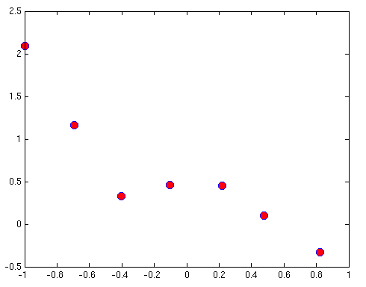
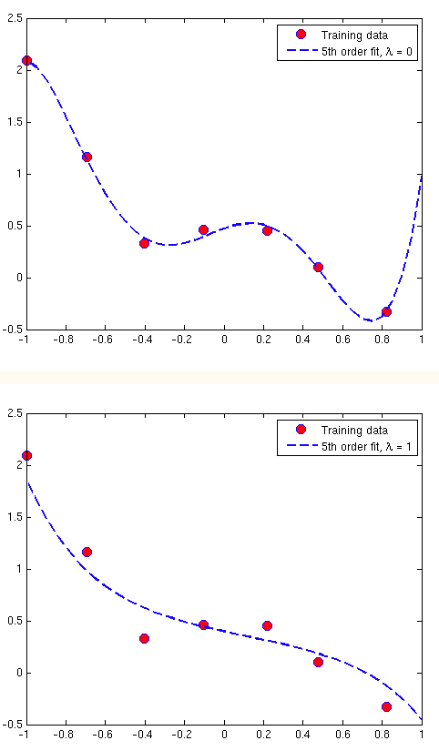
Regularised Logistic Regression
Regularised Logistic Regression
Are two events related (e.g. X and Y)?, how?
Can we use the data to develop a mathematical model (formula) for prediction?
If there was a perfect linear relationship between X and Y, then:
However:

Slide 10
GenePEN
Regularised Logistic Regression¹
GenePEN identifies compact network activity alterations in functional omics datasets.
Aim:
To find a sparse set of discriminative genes that form a large connected subgraph of the input graph.
Regularised Logistic regression based on a convex optimisation problem:
Where f(w,v) is the expected logistic loss:
And penalty function is defined by¹:
¹ Vlassis, N., Glaab, E. (2015) GenePEN: analysis of network activity alterations in complex diseases via the pairwise elastic net. Stat. Appl. Genet. Mol. Biol. 2015; 14(2): 221-224.

